Slide 1


Titolo presentazione sottotitolo
A Complex Network Perspective On Drug-Disease Interaction
Milano, XX mese 20XX
Luca Muscarnera 10539305
Prova integrativa COMPLESSITÁ NEI SISTEMI E NELLE RETI

Slide 2


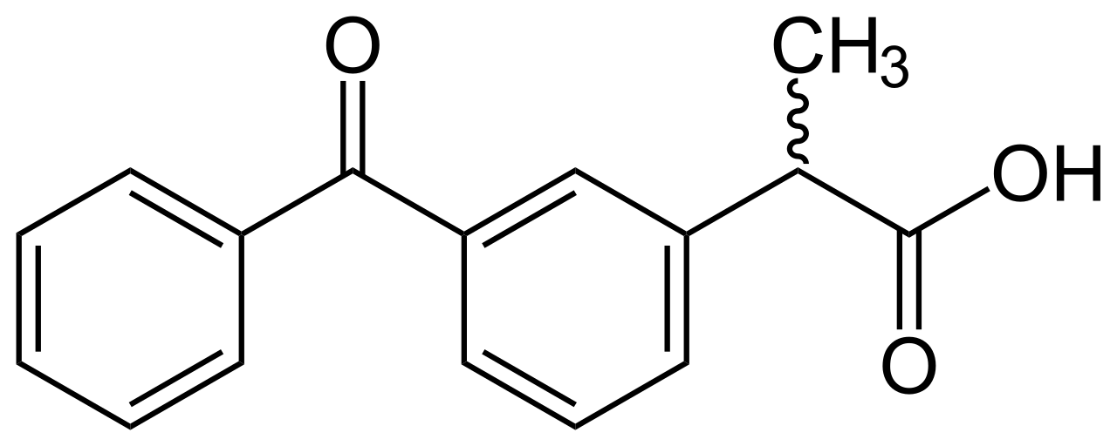
Drug discovery as a quantitative problem
(Computer aided) Drug discovery can be seen as the process of using computation in order to discover previously unknown interaction between a certain set of diseases and a certain set of chemicals.
(we are here)
?
What is causing interaction between some diseases and some chemicals? How can we effectively exploit the information hidden in this interaction?

Slide 3
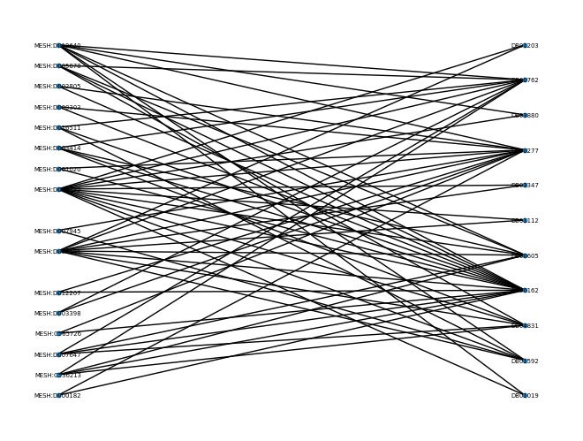
Our Dataset
We focus on the bipartite network Disease-drug association network, hosted by SNAP
The dataset offers a representation of the interaction between diseases and chemicals, without providing any further information a part from the ids (and from the bipartition, implicitly the chemical/disease tag) of the nodes
We have to rely only on topology in order to extract knowledge
Reduced visualization of the network
produced taking only the 30 nodes with highest degree.
remark: the dataset was uploaded in May 27, 2016 and updated 4 years ago (we will see later why this is important)

Slide 4
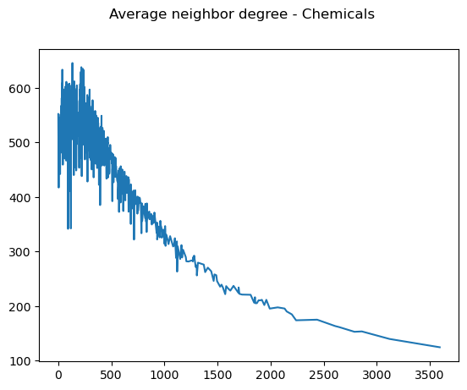
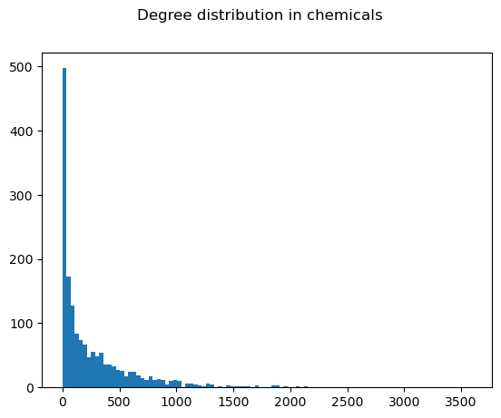
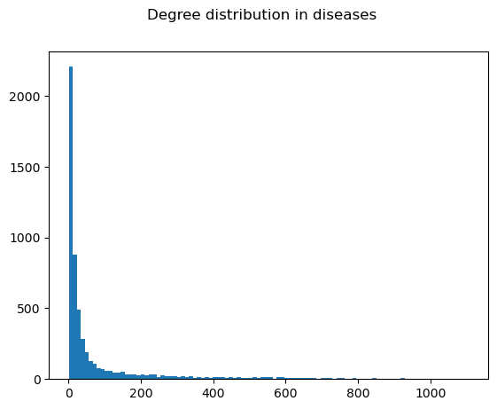
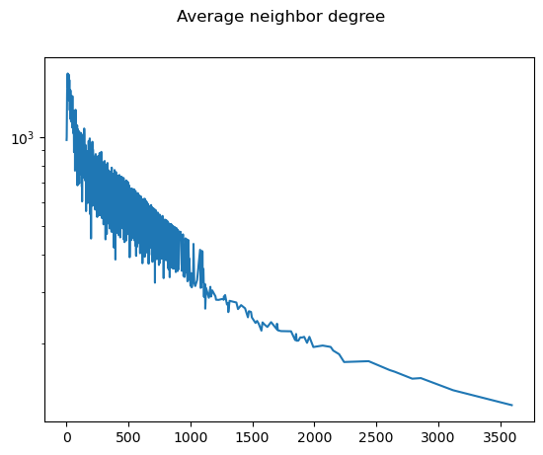
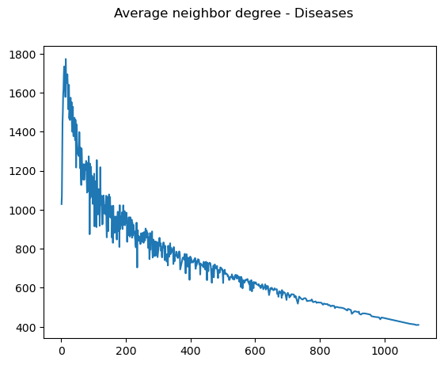
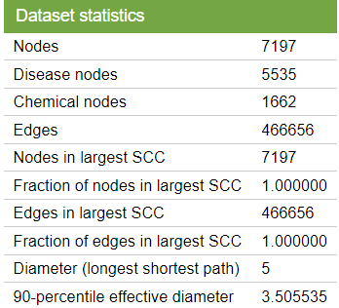
Our Dataset (some statistics...)
Low density and lack of metadata make this problem inherently hard.
The much higher probability for a link to not exists makes statistically challenging to infer the existence of a link. Strong disassortative behavior of the network also poses challenges, due to tendencies of higher degree-central nodes to connect less degree-central ones (some chemicals interact with a lot of diseases that are almost exclusively cured by that chemical and some diseases interact with a lot of chemicals which are useful only to those diseases)

Slide 5
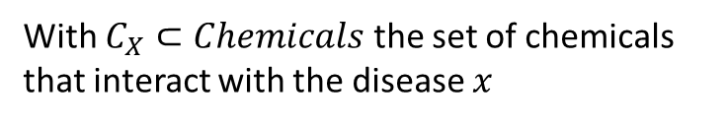
An agnostic approach on topological similarity between Diseases
A first approach was based on inducing a metric of similarity between diseases and then using it to perform collaborative filtering
$$S_{ab}=\left|C_{a}∩C_{b}\right| ∀a,b∈Diseases$$
With $C_{X}⊂Chemicals$ the set of chemicals that interact with the disease $x$
Heuristically, we model the similarity among diseases as the tendency to interact with the same chemicals. The spectrum of information that describes each diseases is then implicitely defined solely based on their interactions
Do diseases really «choose» chemicals, in the same way human beings choose products?
Are we neglecting some piece of information?

Slide 6
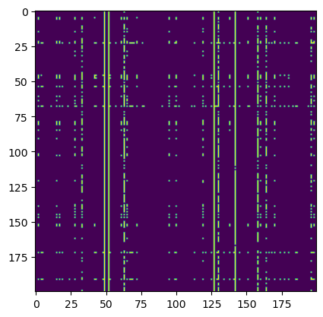
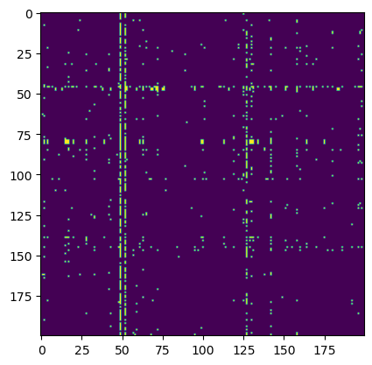
An agnostic approach on topological similarity between Diseases
Applying collaborative filtering we obtain an expression for the Predicted Biadjacency Matrix
$${\hat{B}}_{ij}=\frac{\sum_{k}{S_{ik}B_{kl}}}{\sum_{k}{S_{ik}}}$$
Unfortunately, this is shown insufficient in capturing the dynamics of the phenomena that generate the network
Predicted
Ground truth
Captures part
Of the information
But in a «underfitted» way

Slide 7
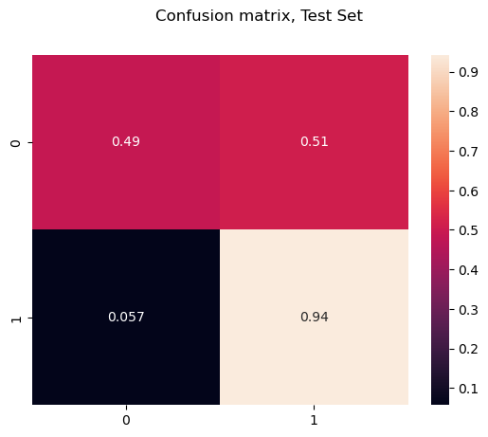
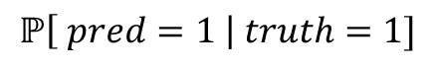
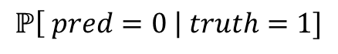
Some metrics on why topological based similarity is NOT enough
$$ℙ\left[ pred=0 \right| truth=1]$$
$$ℙ\left[ pred=1 \right| truth=1]$$
If we restrict to positives, we are not doing better than a random classifier...

Slide 8
The need a more robust model
Commuting a method thought for being used on human people was not able to deal with this kind of problem. We need to build a model which is more «tight» with respect to our problem
Reality
Models
information
We need to rethink our model in order to bring it closer to the reality we are trying to represent
Part of reality
complexity
Moving therefore from an incomplete representation of reality to a richer one

Slide 9

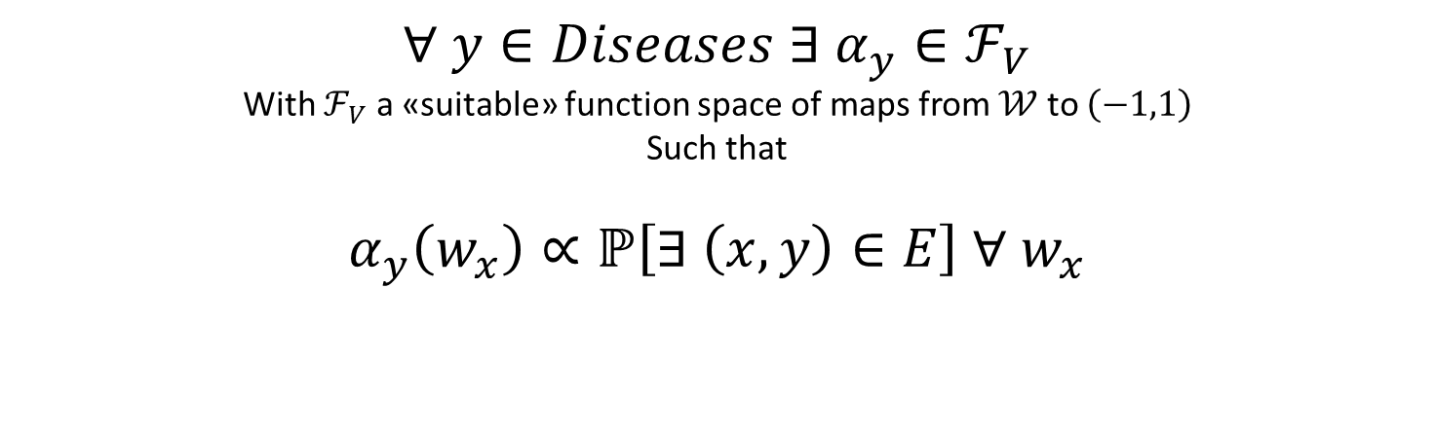
An abstract framework : Information packets hypothesis
Hypothesis: every chemical contains a packet of information that «completely» characterizes it in the context of our problem
$∀ x∈Chemicals ∃ w_{x}∈𝒲$
with $𝒲$ a «suitable» space
Instead, every disease is equipped with a «personal» function, that makes it able to «read» the information packet and compute a measure of affinity
$∀ y∈Diseases ∃ α_{y}∈ℱ_{V}$
With $ℱ_{V}$ a «suitable» function space of maps from $𝒲$ to $\left(−1,1\right)$
Such that
$α_{y}\left(w_{x}\right)∝ℙ\left[∃ \left(x,y\right)∈E\right] ∀ w_{x}$

Slide 10
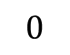
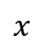
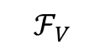
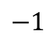
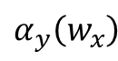
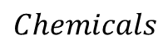
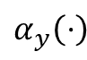
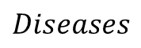
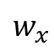
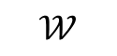
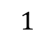
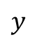
An abstract framework : Information packets hypothesis
$$Diseases$$
$$Chemicals$$
$$y$$
$$x$$
$$ℱ_{V}$$
$$𝒲$$
characterized
by
$$w_{x}$$
equipped with
$$α_{y}\left(⋅\right)$$
-1 denotes certain incompatibility between Y and X
+1 denotes certain interaction between Y and X
$$−1$$
$$0$$
$$α_{y}\left(w_{x}\right)$$
$$1$$
0 denotes complete lack of information

Slide 11
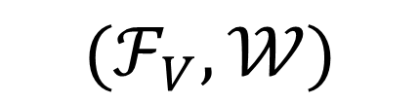
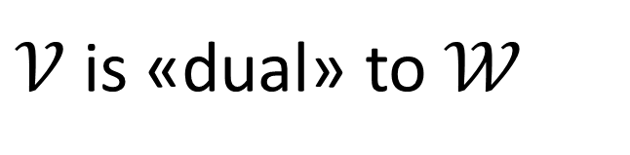
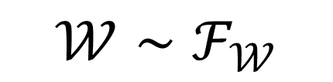
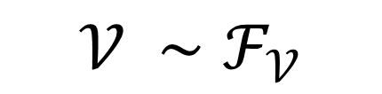
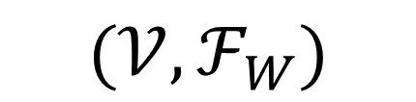
Beyond abstraction: retrieving the structure of the spaces
Assumption : the choice of «who reads» and «who gets read» is totally arbitrary
We could produce an equivalent model «inverting» the roles
$$(ℱ_{V},𝒲)$$
$$(𝒱,ℱ_{W})$$
Hence we can infer these «characteristics» of the involved spaces
$$𝒱 ∼ℱ_{𝒱}$$
$𝒱$ is «dual» to $𝒲$
they carry the same information!
$$𝒲∼ℱ_{𝒲}$$
The morphism that «interchanges» the models
also inverts «roles»

Slide 12
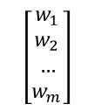


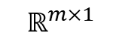
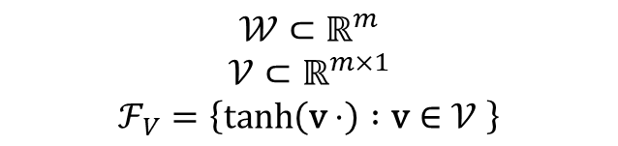

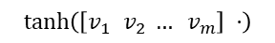

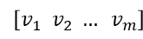
An almost numerical version of the framework
Exploting the assumptions made previously, we can formulate the following model
$$ℝ^{m}$$
$$ℝ^{m×1}$$
$$𝒲$$
$$𝒱$$
$$\left[\begin{aligned}w_{1} \\ w_{2} \\ … \\ w_{m}\end{aligned}\right]$$
$\left[v_{1} v_{2} … v_{m}\right]$
$$𝒲⊂ℝ^{m}$$
$$𝒱⊂ℝ^{m×1}$$
$$ℱ_{V}=\left\{\tanh\left(\text{v}⋅\right) :\text{v}∈𝒱 \right\}$$
$$ℱ_{𝒱}$$
$$\tanh\left(\left[v_{1} v_{2} … v_{m}\right] ⋅\right)$$

Slide 13
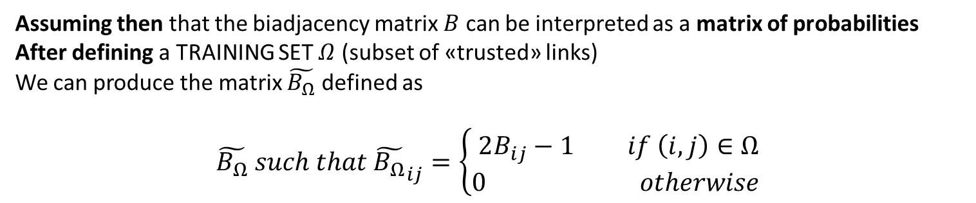
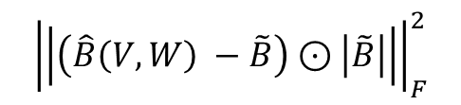
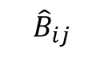
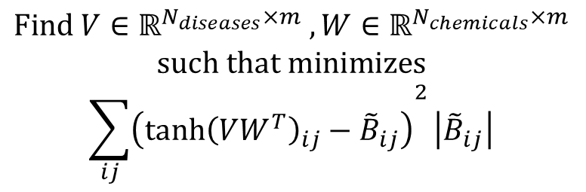
The optimization problem
Assuming then that the biadjacency matrix $B$ can be interpreted as a matrix of probabilities After defining a TRAINING SET $Ω$ (subset of «trusted» links) We can produce the matrix $\tilde{B_{Ω}}$ defined as $$\tilde{B_{Ω}} such that {\tilde{B_{Ω}}}_{ij}=\left\{\begin{aligned}2B_{ij}−1 if \left(i,j\right)∈Ω \\ 0 otherwise \end{aligned}\right.$$
Leading to a «naive» version of the optimization problem to retrieve the information packets
$$\text{Find} V∈ℝ^{N_{diseases}×m} , W∈ℝ^{N_{chemicals}×m}$$ $\text{such} \text{that} \text{minimizes}$ $${\sum_{ij}{\left({\tanh{{\left(VW^{T}\right)}_{ij}}−\tilde{B}}_{ij}\right)}}^{2}\left|{\tilde{B}}_{ij}\right|$$
$${\left|\left|\left(\hat{B}\left(V,W\right) −\tilde{B}\right)⊙\left|\tilde{B}\right|\right|\right|}_{F}^{2}$$
$${\hat{B}}_{ij}$$
Zero contribution of complete uncertain entries

Slide 14
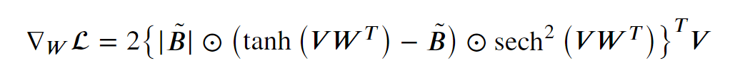
The optimization problem – lack of convexity (sketch of proof)
There is still some problem to tackle...
A gradient based optimizer can get trapped in local optima / saddle points
$$col\left(W\right)∈\ker\left( … \right)⇒∇_{V}ℒ=0$$
$$col\left(V\right)∈\ker\left( …^{T}\right)⇒∇_{W}ℒ=0$$

Slide 15
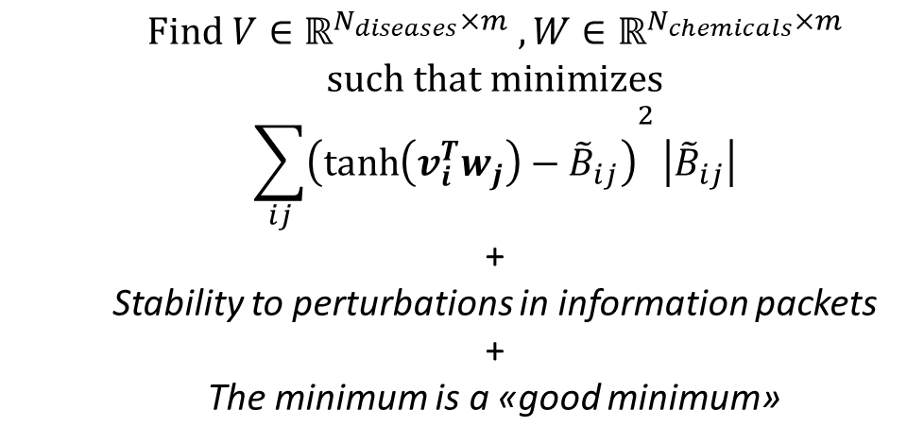
The optimization problem
A less naive version of the optimization problem could read as...
$$\text{Find} V∈ℝ^{N_{diseases}×m} , W∈ℝ^{N_{chemicals}×m}$$ $\text{such} \text{that} \text{minimizes}$ $${\sum_{ij}{\left({\tanh\left(v_{i}^{T}w_{j}\right)−\tilde{B}}_{ij}\right)}}^{2}\left|{\tilde{B}}_{ij}\right|$$
+ Stability to perturbations in information packets + The minimum is a «good minimum»
Problem: the optimization task is not convex and moreover could be sensitive to initial guess on the matrices
We want the problem to be well posed and resilient to initial conditions.

Slide 16
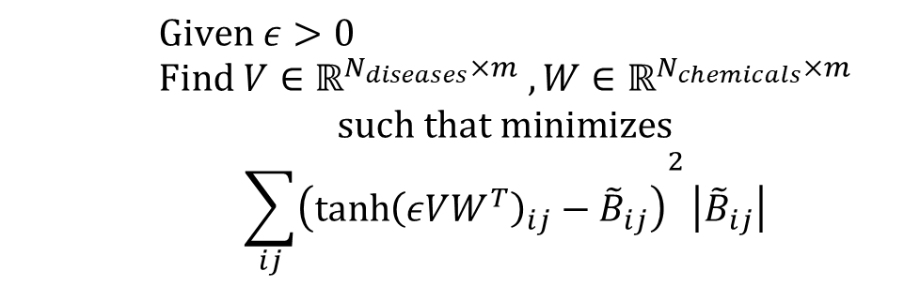
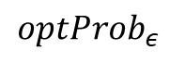
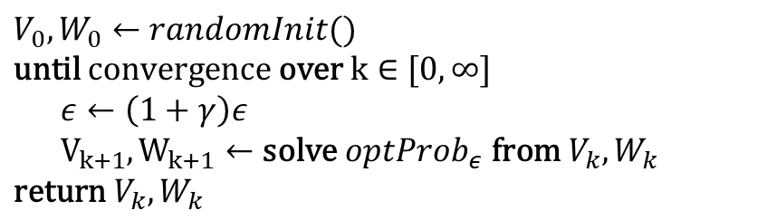
A greedy numerical scheme
Let us define a family of optimization problems, indexed by a $ε∈ℝ_{+}$
$$\text{Given} ε>0 \\ \text{Find} V∈ℝ^{N_{diseases}×m} , W∈ℝ^{N_{chemicals}×m}$$ $\text{such} \text{that} \text{minimizes}$ $${\sum_{ij}{\left({\tanh{{\left(εVW^{T}\right)}_{ij}}−\tilde{B}}_{ij}\right)}}^{2}\left|{\tilde{B}}_{ij}\right|$$
$$optProb_{ε}$$
Paired with the following numerical scheme, with $γ∈ℝ_{+}$ an hyperparemeter of the algorithm
$V_{0},W_{0}←randomInit()$ $\text{until} \text{convergence} \text{over} \text{k}∈[0, ∞]$ $ε←\left(1+γ\right)ε$ $V_{k+1},W_{k+1}←\text{solve} optProb_{ε} \text{from} V_{k},W_{k}$
$\text{return} V_{k},W_{k}$
Implemented as a single gradient descent step

Slide 17
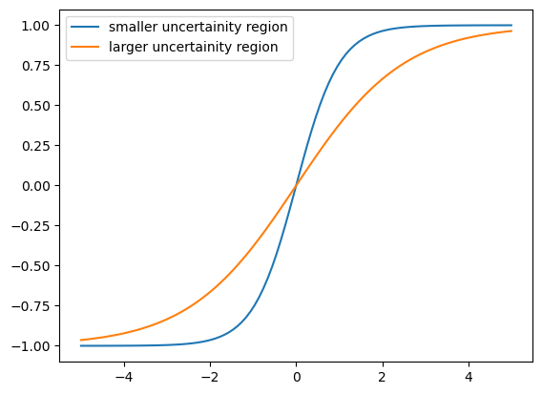
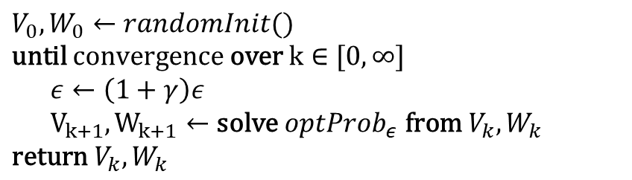
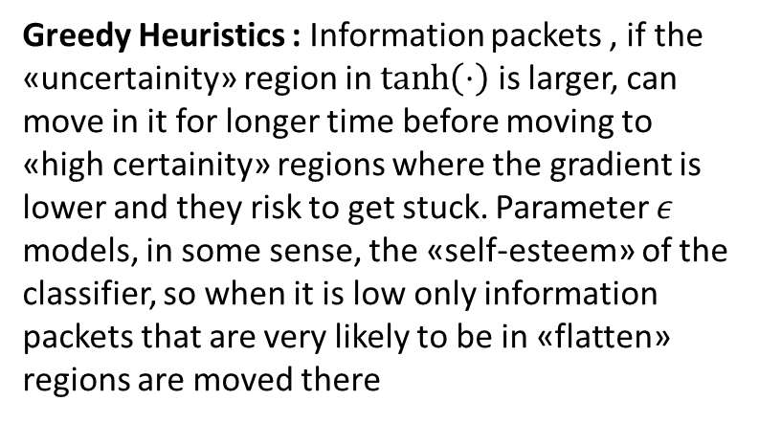
A greedy numerical scheme
Ok... But why should it work? What is the Heuristics?
$V_{0},W_{0}←randomInit()$ $\text{until} \text{convergence} \text{over} \text{k}∈[0, ∞]$ $ε←\left(1+γ\right)ε$ $V_{k+1},W_{k+1}←\text{solve} optProb_{ε} \text{from} V_{k},W_{k}$
$\text{return} V_{k},W_{k}$
Greedy Heuristics : Information packets , if the «uncertainity» region in $\tanh\left(⋅\right)$ is larger, can move in it for longer time before moving to «high certainity» regions where the gradient is lower and they risk to get stuck. Parameter $ε$ models, in some sense, the «self-esteem» of the classifier, so when it is low only information packets that are very likely to be in «flatten» regions are moved there

Slide 18
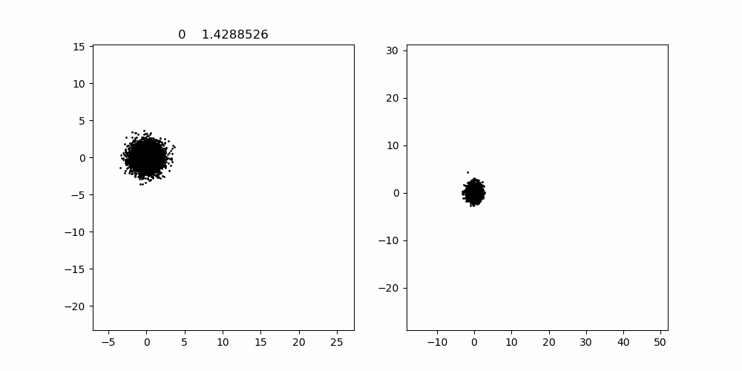







Experiments and Embedding visualization
Experimental results seem to validate the proposed heuristics
$$ε=5⋅{10}^{−3} \\ γ=5⋅{10}^{−3}$$
$$m=2$$
$$V$$
$$W$$
$$ε=5⋅{10}^{−3} \\ γ=5⋅{10}^{−4}$$
$$m=2$$
$$V$$
$$W$$

Slide 19



Some metrics...
Scatter plot of the confusion matrices diagonal elements over 500 simulations , different test/train (90%) set each simulation, $m=8$
Average confusion matrix

Slide 20


Proof of concept – Multidimensional Scaling of information packets
Given a certan disease information packet we can select the near information packets, and perform multidimensional scaling on its neighbors in order to perform a mesoscale analysis of diseases of the network.
We were able to recover medical «closeness» between diseases, in some cases unknown at the time of dataset production

Slide 21




Proof of concept
A report of two cases of chronic serious manganese poisoning treated with sodium para-aminosalicylic acid Ky Shuqin, Deng Haishang, Xie Peiyi, Hu Wanda
The association between chronic obstructive pulmonary disease and Parkinson’s disease: a nationwide population-based retrospective cohort study
C.-H. Li, W.-C. Chen, W.-C. Liao, C.-Y. Tu, C.-L. Lin, F.-C. Sung, C.-H. Chen, W.-H. Hsu

Slide 22




Proof of concept
Chemical «neighbors» of alprazolam ($m=30$, «slow» $γ$)

